Slide 1
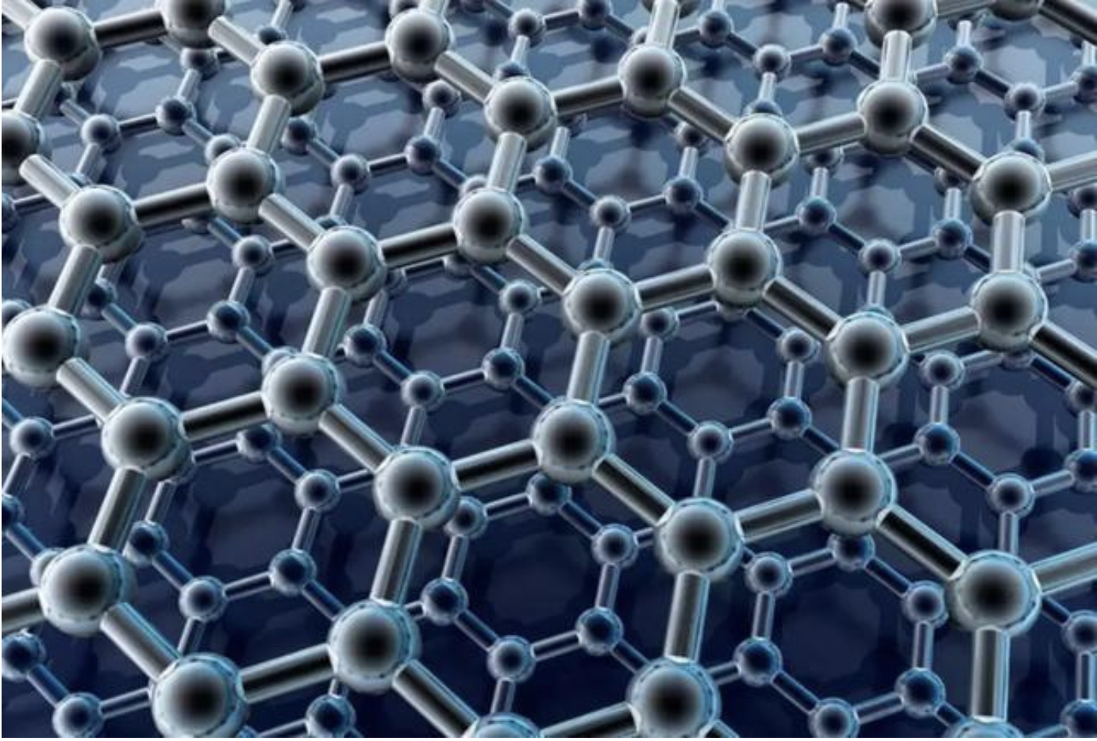

Coherent control of a hybrid superconducting circuit made with graphene-based van der Waals heterostructures
報告者：洪立翰
指導教授：邱奎霖教授

Slide 2
Outline
Introduction—Superconductor, Cooper pair box, van Der Waals materials.
Graphene—Characteristic, looks.
Measurement—Fabry-Perot cavity, Rabi oscillation, Ramsey measurement.
Conclusion—T1 and T2.

Slide 3
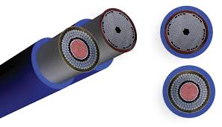
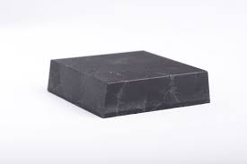
Superconductor
Wire
Bulk
Thin film—Superconducting device
Josephson junction(SQUID)
Superconducting transistor

Slide 4
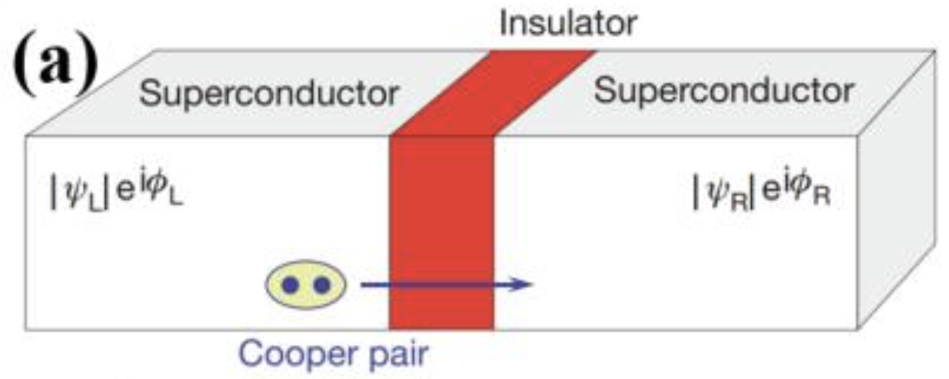
Cooper pair box
in Josephson junction

Slide 5
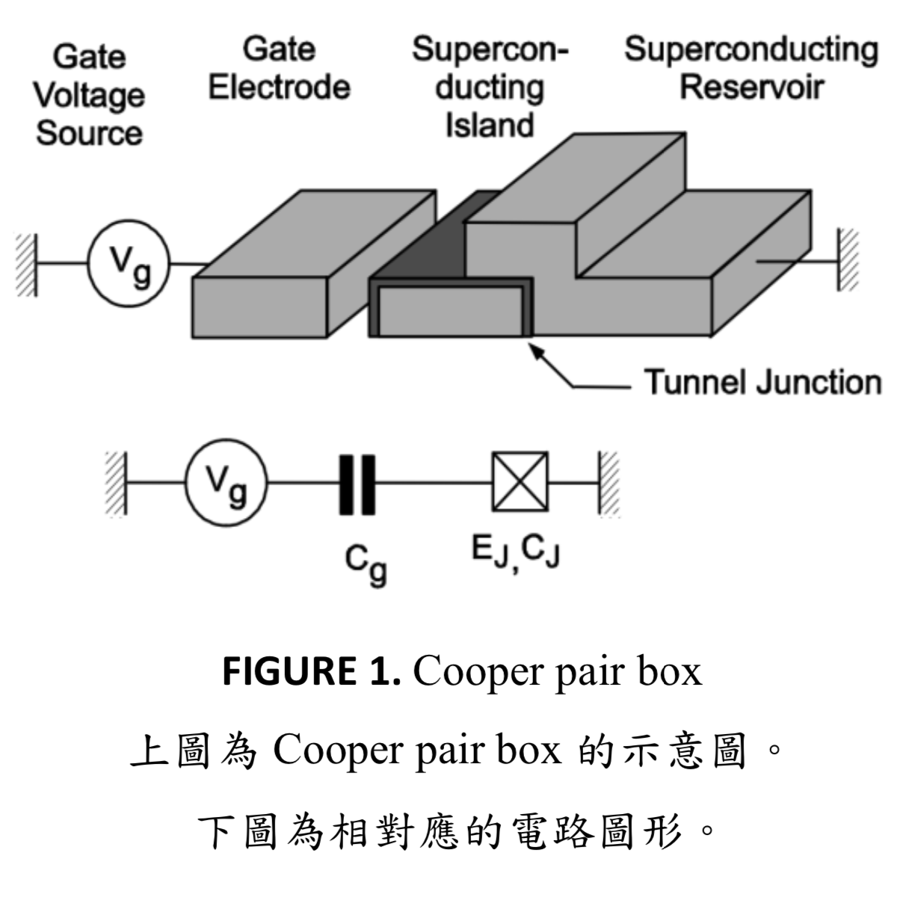
Cooper pair box
Josephon effect + Coulumb blockade
capacitance

Slide 6
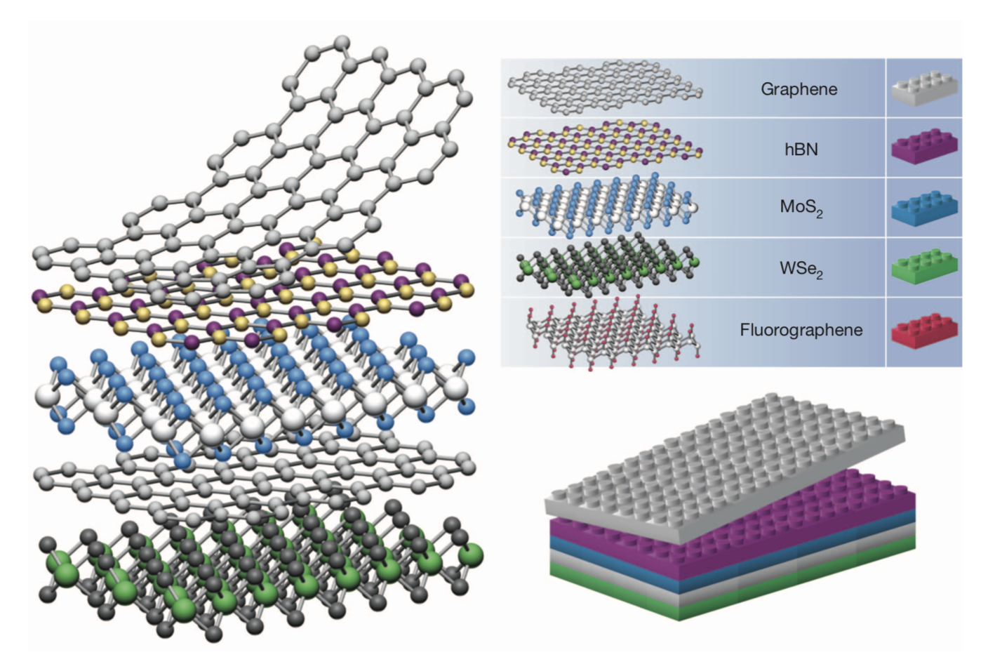
van der Waals materials
2D-materials

Slide 7
Graphene
Resistivity— very low
Nano materiais— the thinnest but also hardest
Electron’s velocity— very fast
Hexagonal lattice
Inherit superconductivity through the proximity effect

Slide 8
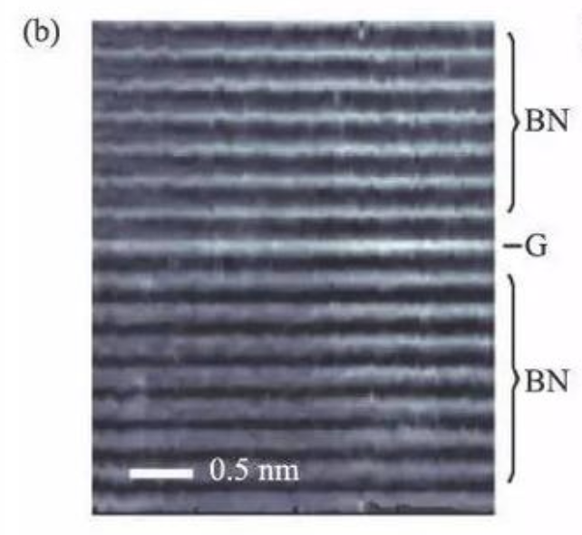
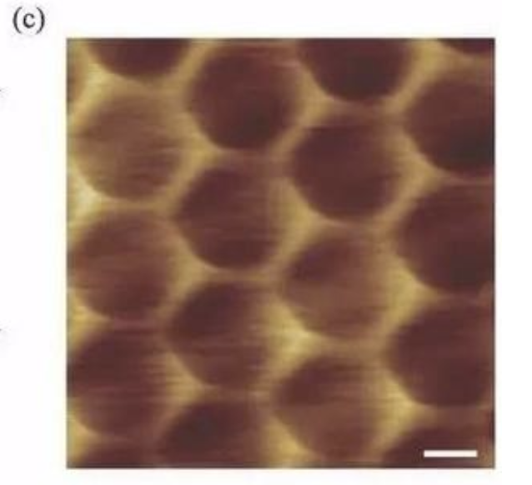
STEM
STM
hBN-Graphene-hBN
van der Waals heterostructures
Superlattice

Slide 9
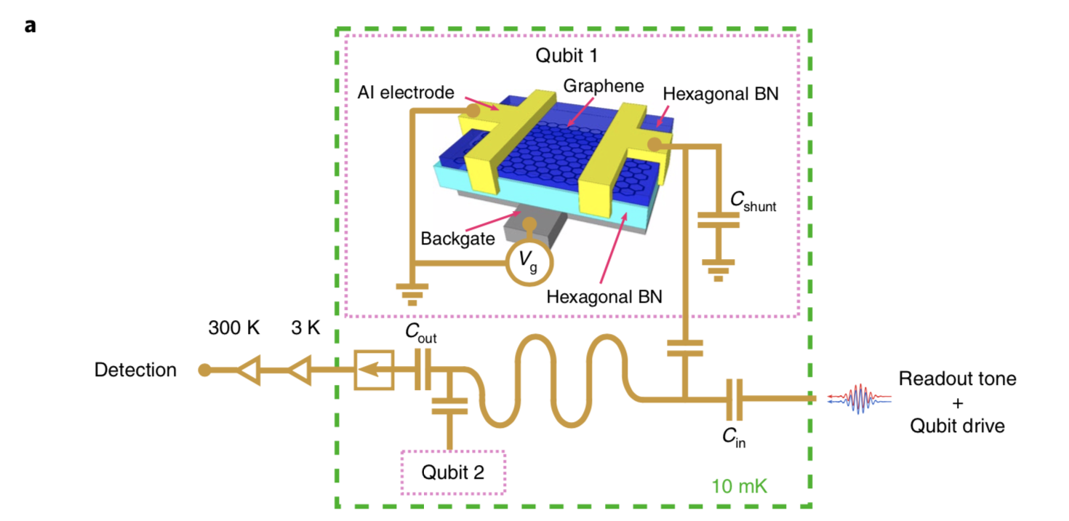
Graphene
S-G-S junction in cQED.
Voltage-tunalbe

Slide 10
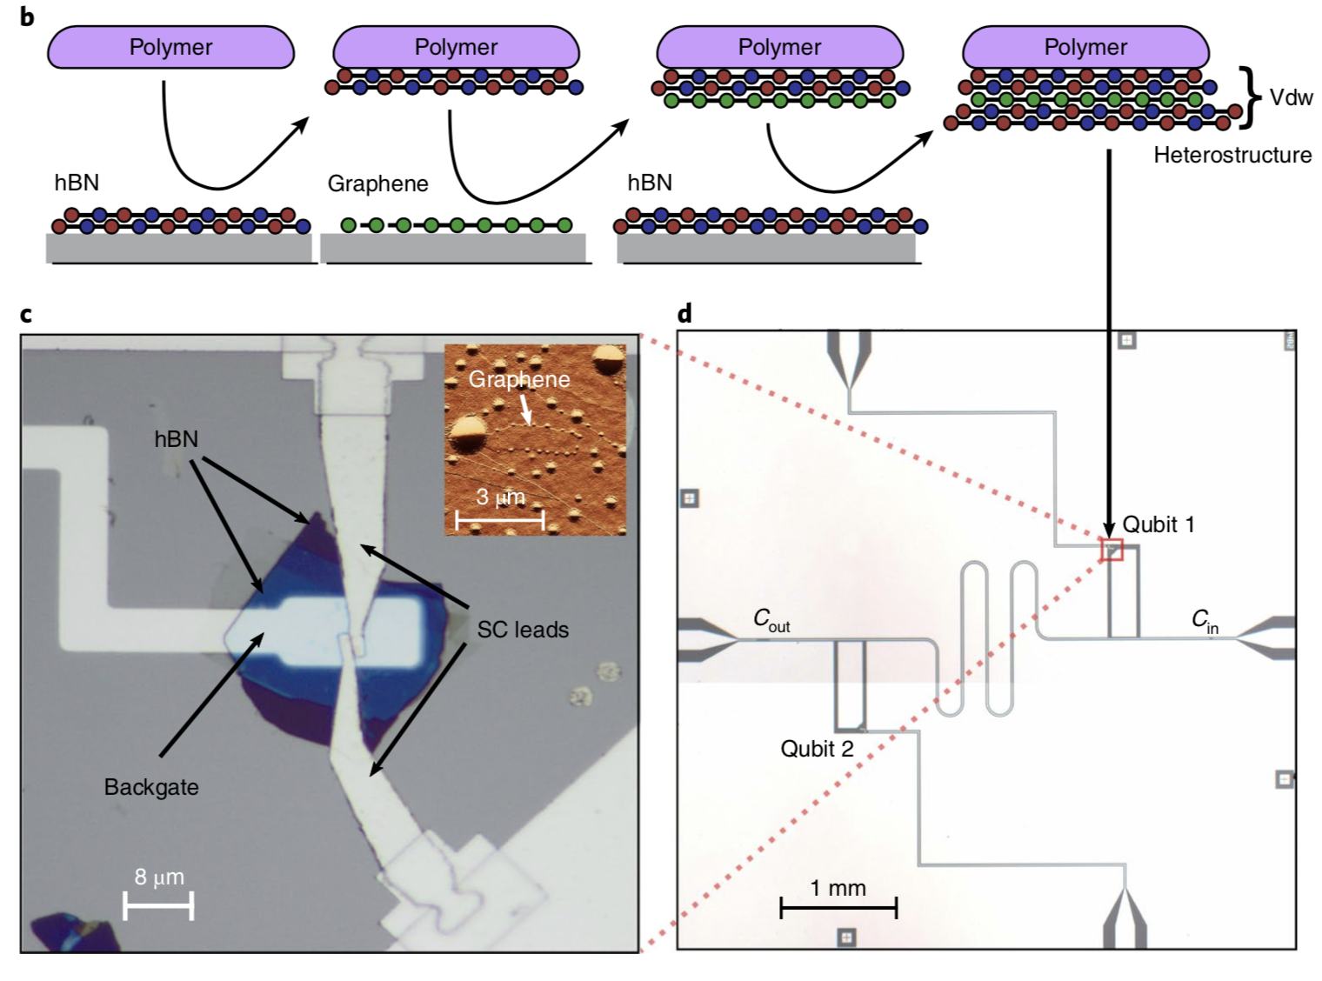
Graphene with hBN
Van der waal materials
Polymer dry picked-up
The bottom hBN
Pristine gate dielectric
The top hBN
Protection
Backgate fixed at 5V
Charge energy Ec is giver by Ec/h=100MHz
We discussed in this paper

Slide 11
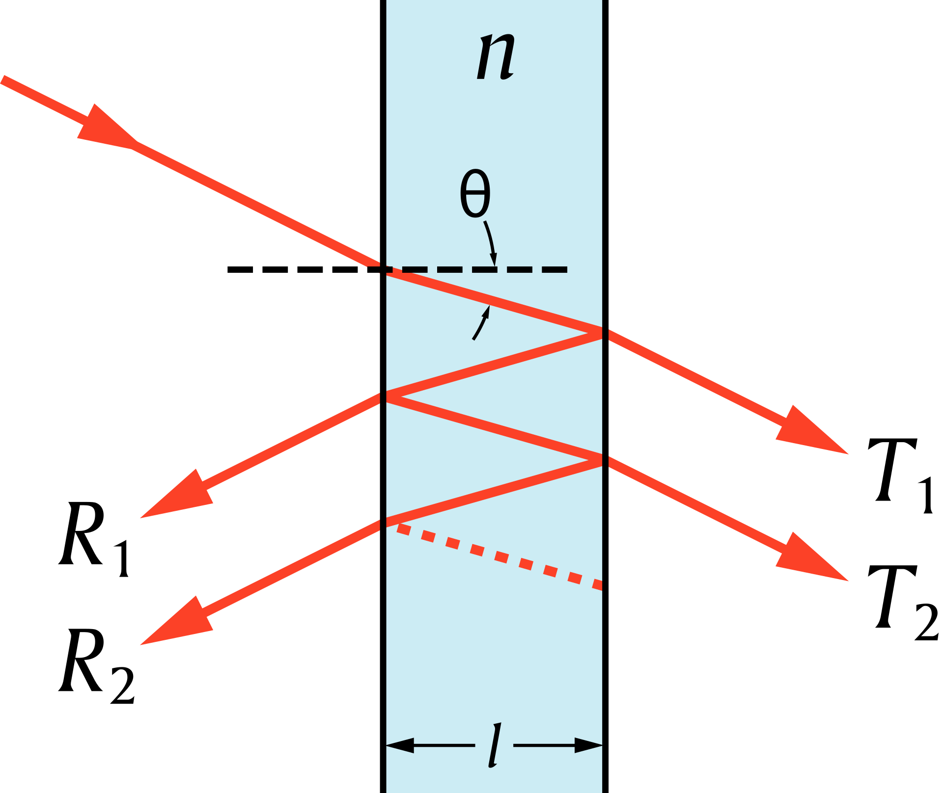
Fabry–Pérot cavity
To get spectroscopy of a graphene transom qubit.
Measure how transmission of the resonator responds to gate voltage.

Slide 12
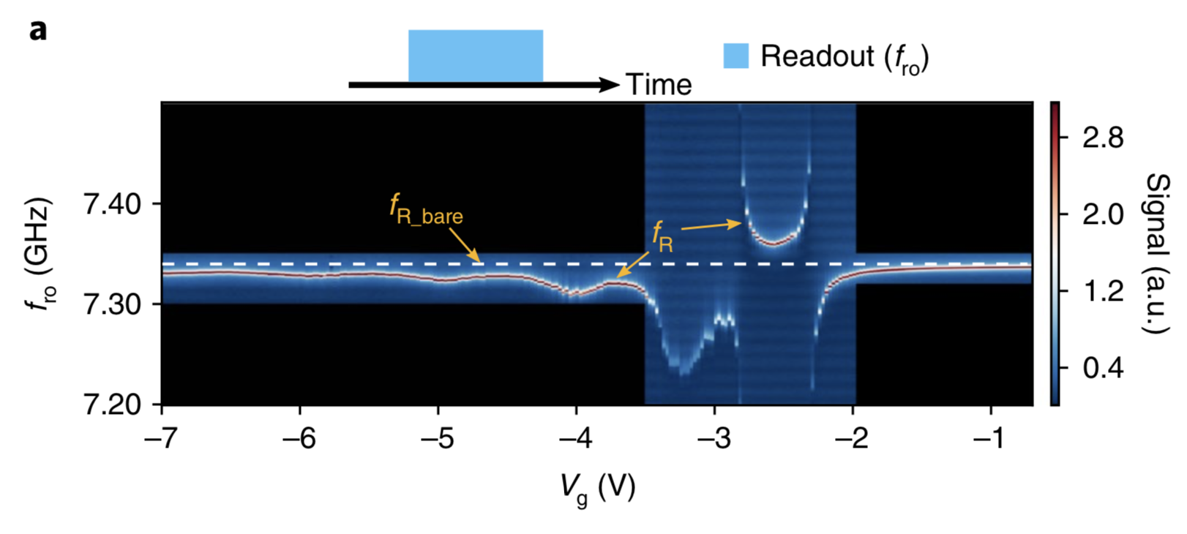
Measurement-
Spectroscopy of a graphene transmon qubit
Frequency—readout(bare)=7.34 Ghz
-2.2
-2.8
Splitting of the cavity
To get gate-voltage
Scanning readout frequency around bare-resonator
Indicating hybridization between the resonator and the qubit in the strong coupling regime

Slide 13
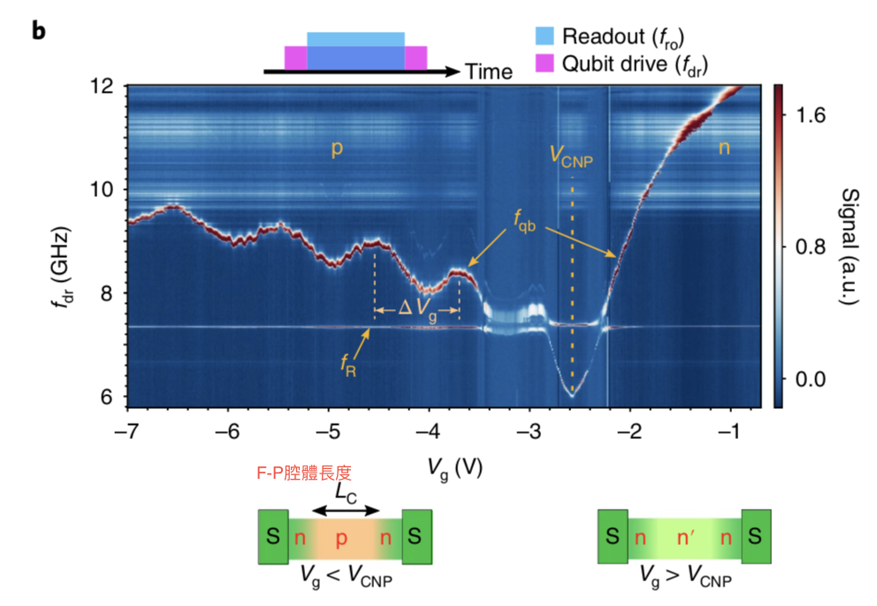
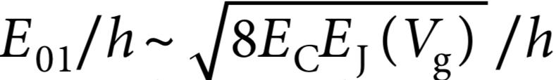
Measurement-
Spectroscopy of a graphene transmon qubit
Frequency qubit：
Josephson current Ic ~90-360nA
Voltage charge neutrality point
= -2.52 (V)
Vg=-4.38 (V),F(dr)=F(qb)=8.811Ghz
Rabi oscillation

Slide 14
Measurement-
Spectroscopy of a graphene transmon qubit
V ( CNP ) = -2.52 V.
When [ drive frequency ] = [ qubit frequency ] = 8.811 Ghz , the pulse induces Rabi oscillation.

Slide 15
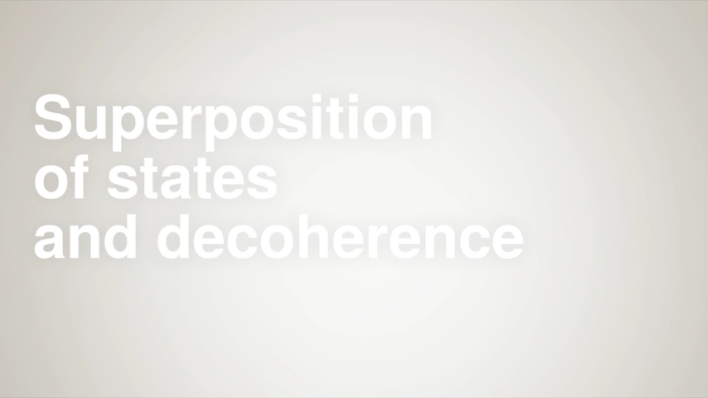
Rabi oscillation

Slide 16
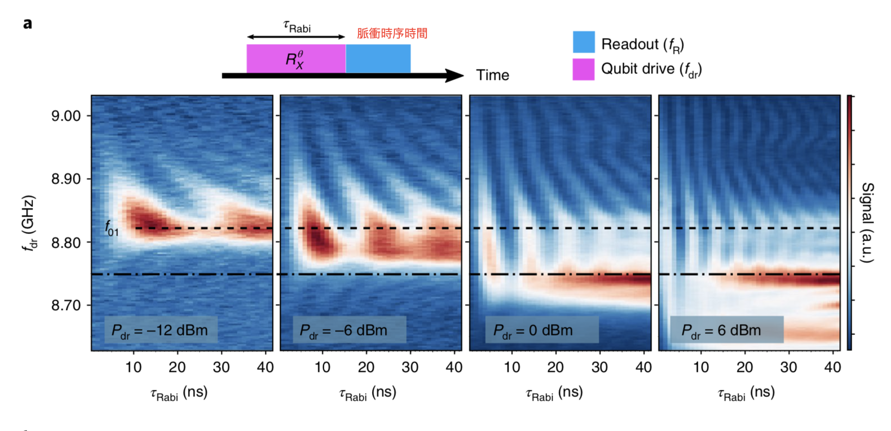
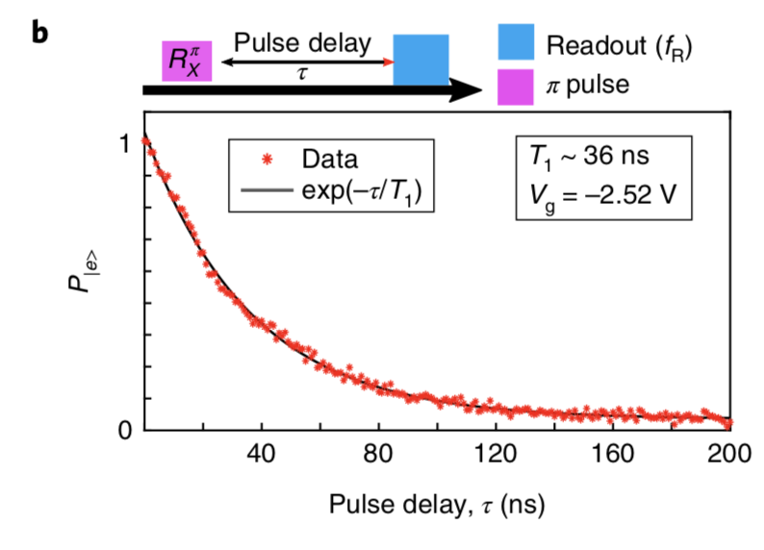
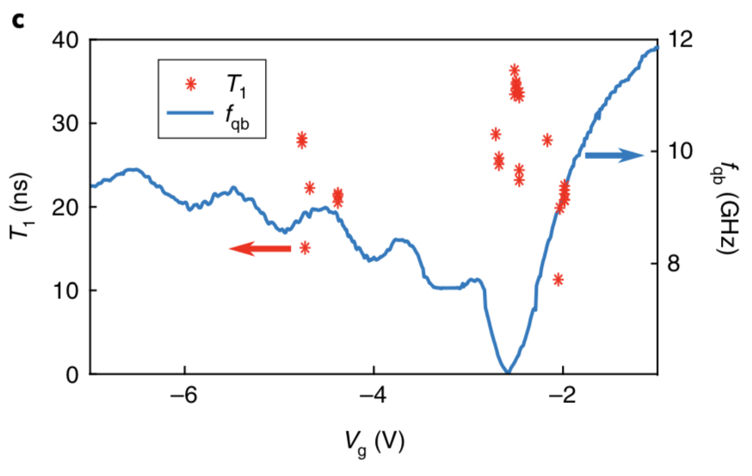

Measurement
Rabi oscillation and energy relaxation of a graphene qubit.
F (01)=8.811Ghz

Slide 17
Measurement
Rabi oscillation and energy relaxation of a graphene qubit.
Energy relaxation time T1 ~ 36 ns
NO strong Voltage(g) dependence of the coherence.

Slide 18
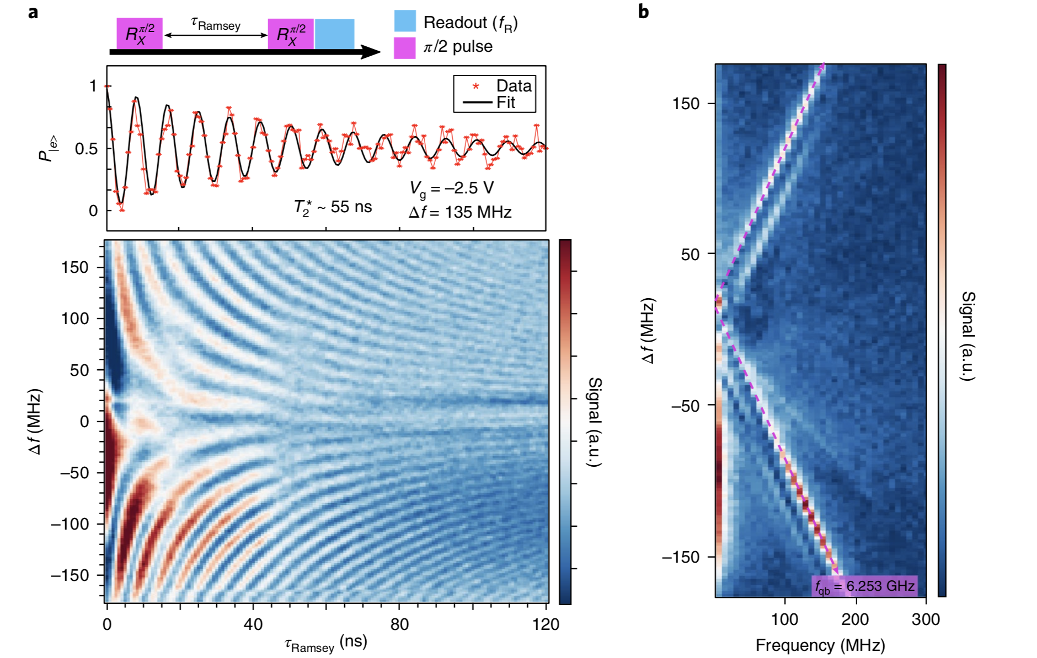

Measurement-
Qubit dephasing and Ramsey measurement
T2*

Slide 19
Measurement-
Qubit dephasing and Ramsey measurement
T1 ~= 36ns
T2~= 55ns
Double ( T1) ~= T2
Qubit coherence is limited by energy relaxation
Coherence in device is not limited by graphene junction
Supercurrent transport characteristics in graphene vary with the Fermi energy.

Slide 20
Conclusion&Futurework-
Graphene-based van Der Waals heterstructures
To engineer a qubit spectrum to optimize charge stability and coherence.
Designed with multiple voltage spots given by the Fabry-Perot oscillation.
It has great potential for extensible superconducting qubit computing
A key element of topological quantum computing

Slide 21
Reference
孔偉成（2018/5）。基於Transmon qubit的量子芯片工作環境的研究與優化。中國科學技術大學。
吳承恩（2007/1）。超導磁通量元之去相干時間量測。國立清華大學
蔣智勳、曾家洲、鐘載淳（2020）。Cooper pair box。國立中興大學。
A.K Geim, I.V Grigorieva（2013/7/25）,Van der Waals heterostructures, Nature, 499, doi : 10.1038/nature12385.
State superposition（2020）,http://toutestquantique.fr/en/microscopy/,（2020/4）

